Slide 1
Doconnect
Capstone Project
G-2
GROUP MEMBERS
Nandkishor kamble
Manish Prajapati
Surabhi Soni
SHAIK ARIF
SUJITH REDDY
Mentor – Anitha George

Slide 2
CONTENT
Introduction
Objective
Abstract
User stories
Admin stories
Web pages
Software requirements
Frontend Angular
Frontend Angular material
Backend spring boot

Slide 3
Introduction
Do Connect is a social is question-and-answer platform that allows users to engage in dialogue with experts in their field. it has become a go-to source for information on a wide range of topics. It is a great resource for learning about new things, finding answers to your questions, and building relationships with other people who share your interests. It's also a great way to stay up-to-date on the latest trends and developments in your field.
To do the above web applications there are two users:-
1. User
2. Admin

Slide 4
Objective
Do connect is a popular Question and Answer from in which techniques questions was asked and answered.
So based on this part we have developed a website from which you learn the things by connecting with the other people through online system.

Slide 5
Abstract
In today’s world the technology has increasing rapidly, so there is no need to wait to learn or to know the things from others. We have more and more facilities to gain knowledge on things that we want to learn.
This website is nothing but DO CONNECT, in this website you can connect with any person and ask your queries and doubts. You can also post your queries in site so that others can see and answer to your queries. This project provides an easy access to Administrators to review queries posted.

Slide 6
User Stories
1. As a user I should be able to login, Logout and Register into the application. 2. As a user I should be able to ask any question under any topic 3. As a user I should be able to Answer any question asked 4. As a user I should be able to answer more than one question and more than one time 5. As a user I should be able to chat with other users. 6. As a user I should be able to upload images to refer

Slide 7
Admin Stories
1. As an Admin I should be able to login, Logout into the application. 2. As an Admin I should be able to get mail as soon as any new Question is asked or any Answers given. 3. As an Admin I should be able to approve the question and Answer. 4 Any Question or Answer will be visible on the platform only if it is approved. 5. As an Admin I should be able to delete inappropriate Questions or Answers.

Slide 8
Use of code
Add a database to your MySQL system. Run spring boot application in Spring Tool Suite. Run angular files from vs code using “ng server” command. Website will server on localhost, we can navigate through browser Register yourself with our website Login our system Answer question asked by various other user Ask question whatever you want to ask (question will be available after admin approve)

Slide 9
Web pages
Registration page Login page Post Question User Dashboard
Admin Dashboard
Chat Box Page

Slide 10
Software Requirements
Frontend : Angular Backend : Java ,Spring Boot Database : MYSQL

Slide 11
Frontend angular material
Provide tools that help developers build their own custom components with common interaction patterns. <mat-card> is a content container for text, photos, and actions in the context of a single subject. <mat-form-field> is a component used to wrap several Angular Material components and apply common Text field styles such as the underline, floating label, and hint messages. <mat-button> are native <button> elements enhanced with Material Design styling

Slide 12
Backend spring boot
Spring-Boot provides a quick way to create a spring based application from dependency management to convention over configuration. Stand-alone Spring applications with negligible efforts. Automatic configuration by creating sensible defaults Provides Starter dependencies / Starter POMs. Supports Maven Provides common non-functional production ready features for a “Real” application such as -security -metrics -Embedded servers

Slide 13
Database MYSQL
MySQL allows users to connect to a specific database on the server and issue requests. This system can run on virtually on any platform UNIX and Windows. MySQL also comes with a source code. MySQL is used at the enterprise level because of its security. Provides best open source RDBMS being developing web based software applications. MySQL uses a standard from of the wll known SQL data language. Widely accepted. Database is a separate application that stores a collection of tables and related data.

Slide 14
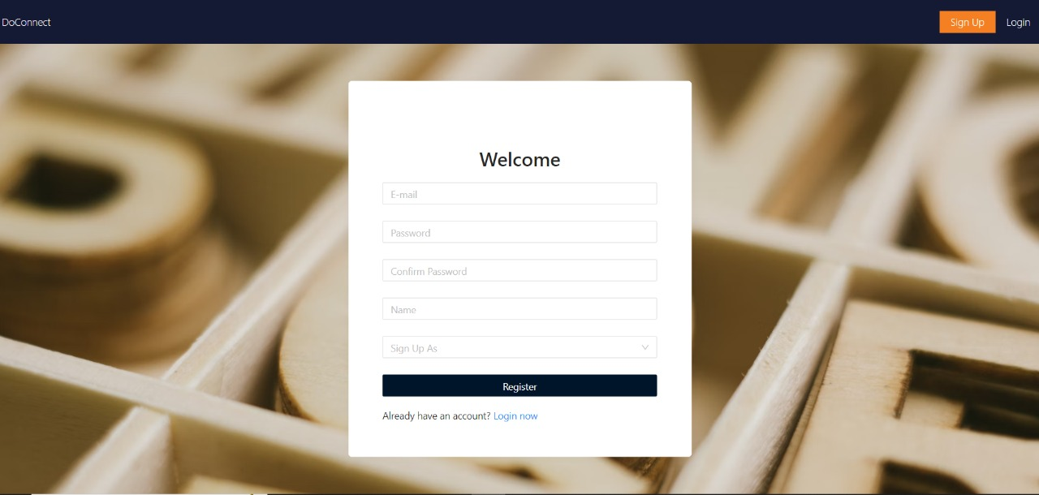
Registration web page

Slide 15
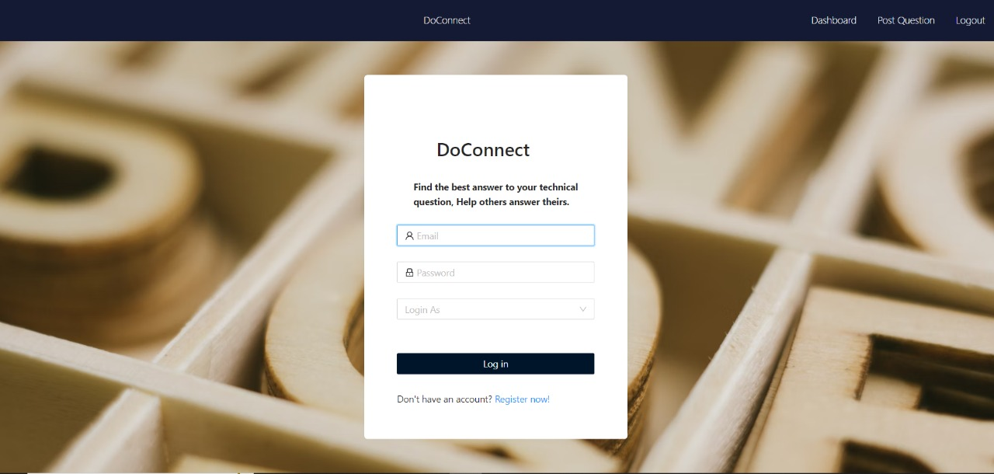
login Web Page

Slide 16
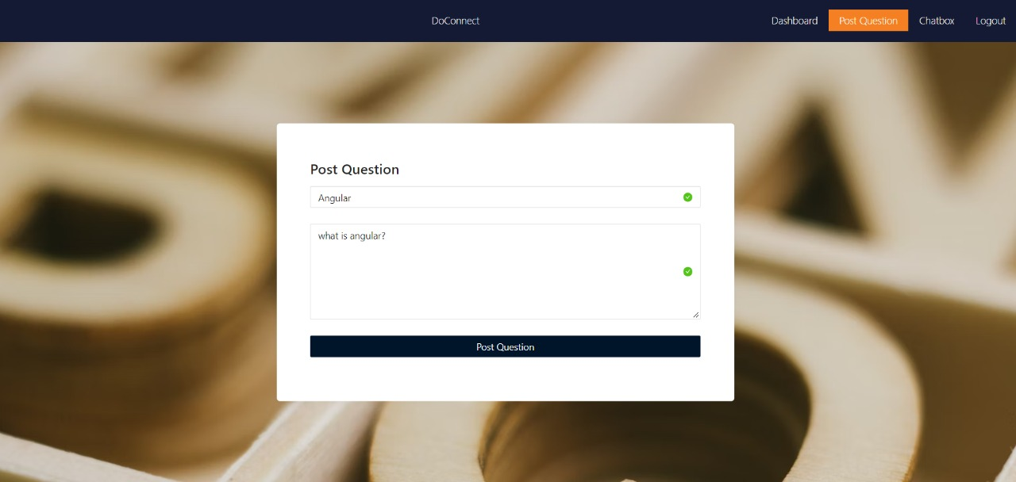
Post Question

Slide 17
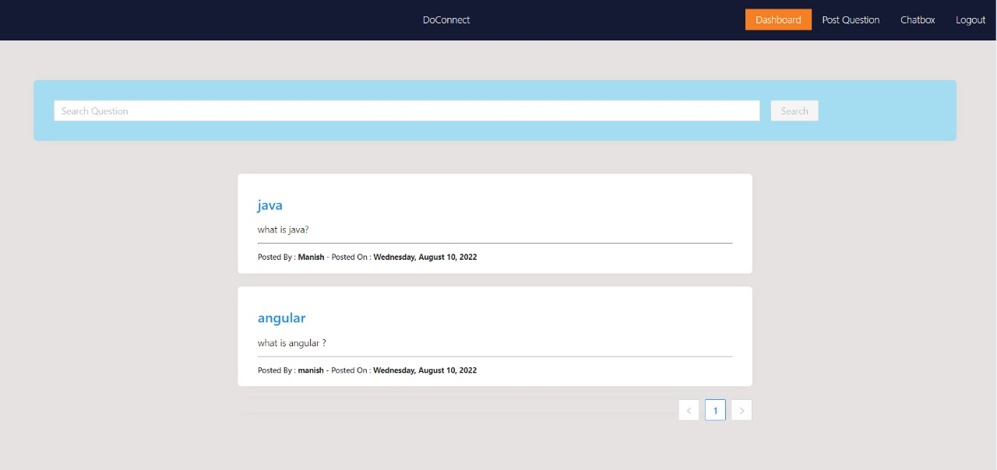
User Dashboard

Slide 18
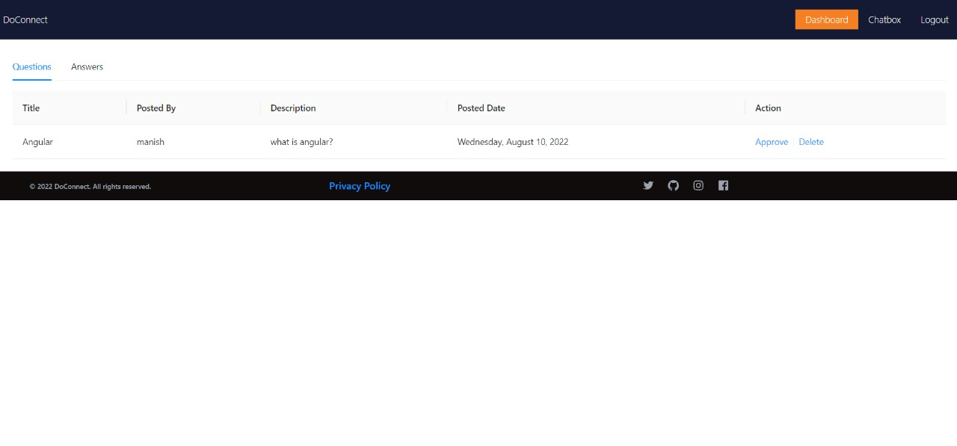
Admin Dashboard

Slide 19
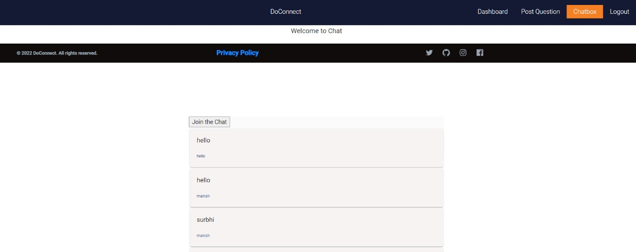
Chat Box

Slide 20
System Specifications
SOFTWARE REQUIREMENTS
Technologies:
Angular
Java Spring Boot,
Languages:
Type Script
Java
SQL Queries
HTML
IDE:
Spring Tool Suite
VS code

Slide 21
HARDWARE REQUIREMENTS
Operating System:
Windows 7/8/10/11
Linux distros
MacOS X or later.
Processor:
Intel or AMD dual core x86 processor.
RAM:
2 GB or above.
Hard disk:
500 MB of free disk space or more.

Slide 22
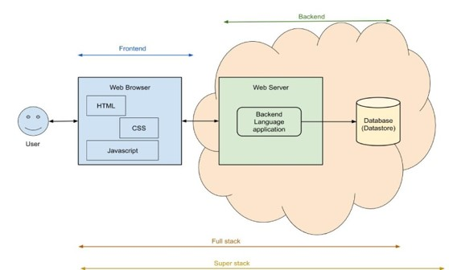
Total Project View

Slide 23
THANK YOU

